Slide 1

Securitas AB
Bond Investor Presentation
Andreas Lindback - Group CFO
Sean Grace – Group Treasurer
August 29, 2023

Slide 2
Disclaimer – Advertisement within in the meaning of the Prospectus Regulation (EU) 2017/1129
This presentation is provided for information purposes only and on the basis of the acceptance of this disclaimer and does not purport to be a completed description of all material terms or of the terms (which may be different from the ones referred to herein) of an offering that may be finally consummated. The information contained (the “Information”) herein has not been reviewed or approved by any rating agency, government entity, regulatory body or listing authority and does not constitute listing particulars in compliance with the regulations or rules of any stock exchange. The Information does not constitute an offer to sell or the solicitation of an offer to subscribe for or buy any security, nor a solicitation of any vote or approval in any jurisdiction, nor shall there be any sale, issuance or transfer of any securities referred to in this presentation in any jurisdiction in contravention of applicable law. The Information and any questions and answers that follows the presentation do not contain all of the information that is material to an investor. By attending a meeting where this Information is presented, or by reading this presentation, you agree to be bound by the following limitations and conditions and, in particular, will be taken to have represented, warranted and undertaken that you have read and agree to comply with the contents of this disclaimer including, without limitation, the obligation to keep this document and its contents confidential.
This presentation shall not, under any circumstances, create any implication that there has been no change in the business or affairs of Securitas AB (publ) (reg. no. 556302-7241) (the “Company”) since the date of this presentation or that the information contained herein is correct as at any time subsequent to this date. The Information is furnished by the Company solely for the recipients’ information in connection with a contemplated issue of notes by the Company under its EMTN Programme (the “Notes”). The intended recipients are thus a limited group of potential investors in Notes. The Information is strictly confidential and may not be reproduced, redistributed, published or passed on to any person , directly or indirectly, in whole or part, for any purpose without the prior written consent of the Company. Failure to comply with this restriction may constitute a violation of applicable securities laws.
Nothing in this presentation should be construed as a profit forecast or profit estimate. Nothing in this presentation should be construed as legal, tax, regulatory, accounting or investment advice, nor as a recommendation or an offer by the Company to sell securities to you or to purchase securities from you, or to underwrite any of the securities or extend to you any credit or similar financing, or to conduct any such activities on your behalf.
This presentation may include "forward-looking statements". Such statements contain the words "anticipate", "believe", "intend", "estimate", "expect", "will", "may", "project", "plan" and words of similar meaning. All statements included in this presentation, other than statements of historical facts, are forward-looking statements. Such forward-looking statements involve known and unknown risks, uncertainties and other important factors that could cause actual results, performance or achievements to be materially different from future results, performance or achievements expressed or implied by such forward-looking statements. Such forward-looking statements are based on numerous assumptions regarding present and future business strategies and the relevant future business environment, and no representation, assurance, guarantee or warranty is given in relation to them (whether by the Company or any of its associates, directors, officers, employees or advisers), including as to their completeness, accuracy or the basis on which they were prepared.
NO ACTION HAS BEEN MADE OR WILL BE TAKEN THAT WOULD PERMIT A PUBLIC OFFERING OF ANY SECURITIES DESCRIBED HEREIN IN ANY JURISDICTION IN WHICH ACTION FOR THAT PURPOSE IS REQUIRED. NO OFFERS, SALES, RESALES OR DELIVERY OF ANY SECURITIES DESCRIBED HEREIN OR DISTRIBUTION OF ANY OFFERING MATERIAL RELATING TO ANY SUCH SECURITIES MAY BE MADE IN OR FROM ANY JURISDICTION EXCEPT IN CIRCUMSTANCES WHICH WILL RESULT IN COMPLIANCE WITH ANY APPLICABLE LAWS AND REGULATIONS.
Save as stated below, this presentation is not for distribution in, nor does it constitute an offer of securities in the United States. Neither this presentation nor any copy of it may be taken or transmitted into the United States, its territories or possessions, or distributed, directly or indirectly, in the United States, its territories or possessions or to any US person as defined in Regulation S under the US Securities Act 1933, as amended (the “Securities Act” and “Regulation S”). Any failure to comply with this restriction may constitute a violation of United States securities law. Accordingly, each person viewing this presentation will be deemed to have represented that it is not a US person within the meaning of Regulation S of the Securities Act. Securities may not be offered or sold in the United States absent registration or an exemption from registration. The Company has not registered and does not intend to register any securities that may be described herein in the United States or to conduct a public offering of any securities in the United States.
The communication of this presentation is only being made to those persons falling within Article 12, Article 19(5) or Article 49 of the Financial Services and Markets Act 2000 (Financial Promotion) Order 2005, or to other persons to whom this presentation may otherwise be distributed without contravention of Section 21 of the Financial Services and Markets Act 2000 (“FSMA”), or any person to whom it may otherwise lawfully be made (all such persons being referred to as “relevant persons”). This presentation is only directed at relevant persons and any investment or investment activity to which the presentation relates is only available to relevant persons or will be engaged in only the relevant persons. Solicitations resulting from this presentation will only be responded to if the person concerned is a relevant person. Other persons should not rely or act upon this presentation or any of its contents. This presentation is not intended for distribution to and must not be passed on to any retail client. The distribution of this presentation in jurisdictions other than the UK may be restricted by applicable law and regulation, and therefore any persons who are subject to the laws of any jurisdiction other than the UK should inform themselves of, and observe, any applicable requirements.
None of the Company or any of its affiliates or advisers shall have any liability whatsoever (in negligence or otherwise) for any loss whatsoever arising from any use of this presentation or its contents, or otherwise arising in connection with this presentation. Each recipient of this presentation is advised to seek independent professional advice as to the suitability of any products and to their tax, accounting, credit, legal or regulatory implications.
The Company is under no obligation to accept offers or proposals and the Company reserves the right to change the process or terminate negotiations at any time before a binding agreement has been reached. The Company also reserves the right to negotiate with any party and with any number of parties it wishes. Potential investors’ costs in connection with the process shall be borne by the investors.
This document is not a prospectus for the purposes of Regulation (EU) 2017/1129 of the European Parliament and of the Council of 14 June 2017 on the Prospectus to be published when securities are offered to the public or admitted to trading on a regulated market, and repealing Directive 2003/71/EC (the “Prospectus Regulation”) and has not been prepared, approved or registered in accordance with the Prospectus Regulation or any other law. Accordingly, this document has not been subject to review or approval by the Central Bank of Ireland or any other authority.
Under the Company’s EMTN programme, an offering circular comprising a base prospectus, together with supplements, for the purpose of article 8 of the Prospectus Regulation, was approved by the Central Bank of Ireland on 15 November 2022, 10 March 2023, 23 May 2023 and on 22 August 2023 respectively (together the “Offering Circular”). Potential investors should read the Offering Circular before making an investment decision in order to fully understand the potential risks associated with a decision to invest in the Notes (see “Risk factors” in the Offering Circular). The approval of the Offering Circular should not be understood as an endorsement of the Notes.
The Offering Circular is available at the Company’s website https://www.securitas.com/en/investors/funding/listing-documents/ . The final terms of an issue of Notes under the Company’s EMTN programme will also be made available on the same website. This document is an advertisement and investors should not subscribe for or purchase any Notes except on the basis of information provided in the Offering Circular.

Slide 3
Contents
Highlights 4
Securitas overview and strategy 5-11
Stanley acquisition highlights 12-17
Financial overview 18-23
Financing update 24-26
Investment highlights 27-28

Slide 4
Highlights
  Strong strategic execution and financial performance
  Positive Technology and Solutions growth and margin development
  Post-acquisition deleveraging on track
  BBB- rating affirmed by S&P and outlook revised from stable to positive
  Argentina operations divested in July 2023
  Purpose of proposed new Eurobond is refinancing of existing debt and general corporate purposes
  No further Eurobond issues planned for this year

Slide 5
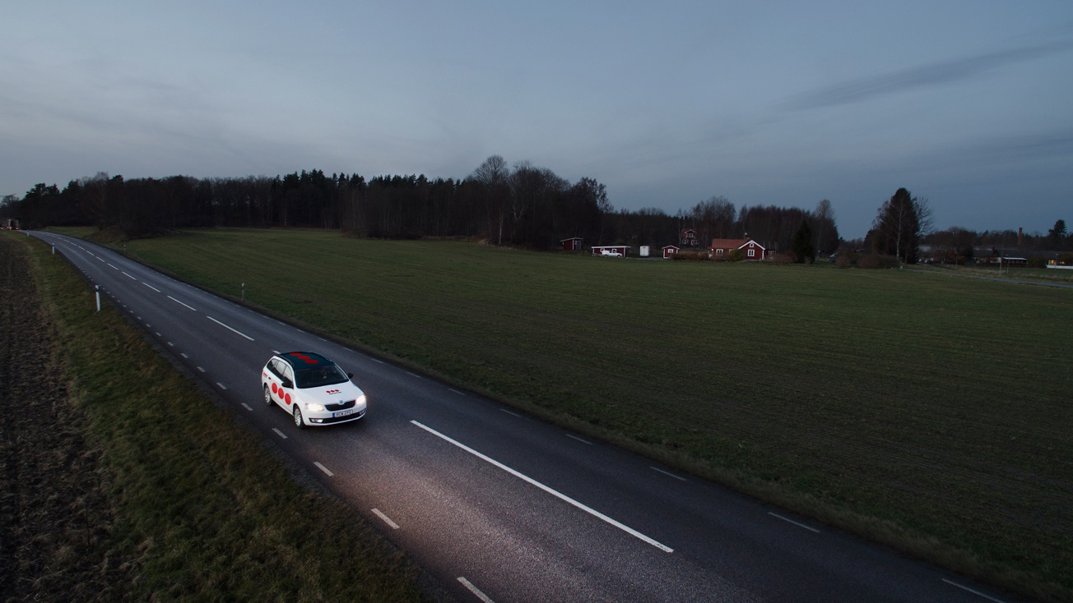
Securitas overview and strategy

Slide 6

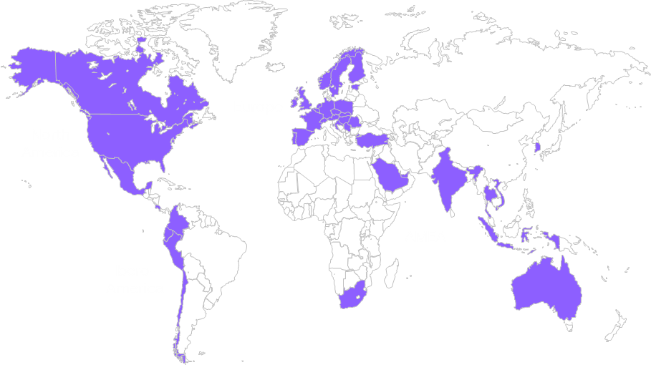

A world leading security solutions provider
Second largest global security provider
Highly diversified client portfolio with stable recurring revenue and cash flows in a continuously resilient and growing security market
Essential services in 44 markets ⁽¹⁾
>650k clients ⁽²⁾ ~90% retention rate
~358 000 employees ⁽²⁾
BSEK 133 2022 sales, BSEK 78 H1 2023
32% - Technology and Solutions portion of total sales H1 2023
86% average operating cash flow since 2015
Russia/Ukraine: no operations
BBB- rating affirmed by S&P – rating outlook revised to positive
Securitas’ security services
Securitas’ global presence ⁽¹⁾
On-site guarding
Corporate risk management
Fire and safety
Mobile services
Remote services
Technology
(1) Adjusted for Argentina divestment (2) Not adjusted for Argentina divestment

Slide 7








Securitas has a long term, unrivalled client base and solutions offering with strong client retention rates
SMEs
Global clients
Leading client offering in our six protective services
Solutions offering
  Combination of people and technology based on client needs
  Invests into the client contract
  Improved retention rates and margin profile
Strong portfolio of recurring revenue
~90% client retention rate
Stable and resilient over economic cycles
Low CAPEX-needs, strong cash generation
On-site guarding
Corporate risk management
Digital client interface
Risk analysis as an important driver for solutions design
Fire and safety
Mobile guarding
Remote services
Technology
Standardized
packages
Tailor-made
solutions

Slide 8

Securitas has a solid track record of delivering on its historical financial targets
2015
2016
2017
2018
2019
2020
2021
Average Result
Profitability Target
Annual real EPS growth target of 10% on average ⁽¹⁾
9%
Covid-19
Cash flow generation Target
Operating cash flow in relation to operating income before amortization of 70-80%
88%
Leverage Target
Net debt/EBITDA target of 2.5x
2.1x
Dividend ratio
Dividend of 50-60 percent of annual net income
53%
Strategic transformation
Increase Technology & Solutions sales by 2x (2018 vs. 2023)
2018
BSEK 20.4
2021 combined
BSEK 38.3
~2x
New financial targets announced in 2022. See coming pages.
Source: Securitas annual reports 2015-2021 (https://www.securitas.com/en/investors/financial-reports/annual-reports/)
(1) Adjusted for IAC

Slide 9
Large and consistently growing market opportunity
Global growth drivers
Positioning Securitas in higher growth and margin markets
Increasing security concerns in general
Increasing income and societal gaps
Rapid urbanisation and industrialisation
Growing awareness of the need to protect critical infrastructure
Increased focus on compliance and sustainability
Growth ⁽¹⁾
Solutions
Data-driven
SaaS
Market size
2022
10%+
Technology ⁽²⁾
BUSD 70
5%
Technology
Solutions ⁽³⁾
Fast growth
Guarding
Guarding
BUSD 135
10%+
20%
Operating margin
Source: Freedonia, OMDIA and management estimates
(1) Not adjusted for current inflationary environment; (2) Commercial electronic security market;
(3) Solutions is specific to Securitas and so a global market size figure is not available

Slide 10
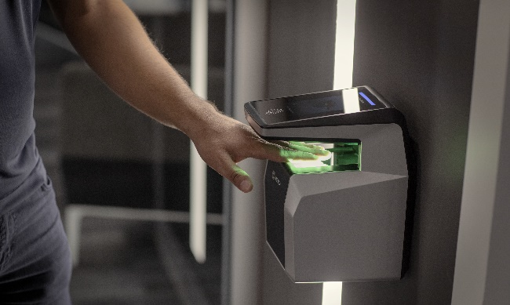
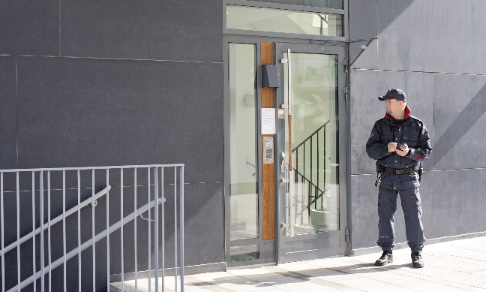
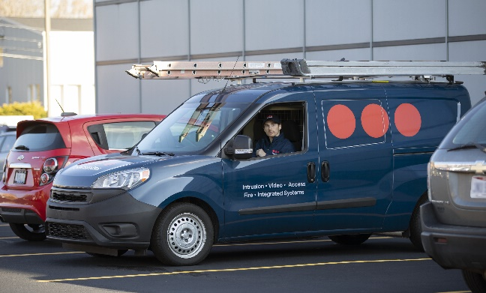

Securitas is positioned to deliver sustainable growth, margins and cash flow
Taking the lead within Technology…
…with quality security services focused on profitability…
…to become a global security solutions partner…
…leveraging our global platform to drive innovation
Outstanding position in the technology market by teaming up with STANLEY Security to deliver superior growth
High recurring revenue, with technology platform further driving shift to cloud and subscription-based business models and growing recurring revenue
Diversified portfolio business with a leading market position globally
Profitability focus in stable high recurring revenue guarding business
Scale, transparency and efficiency gains with digital leadership and acceleration towards solutions
A security solutions partner with leading technology and expertise
Well positioned to serve the comprehensive and increasingly complex needs from global clients to SMEs, through client-specific combination of six protective services
A strong global technology platform future proofing the business for next-generation solutions
Strengthened proposition and profitability upside by scaling Technology & Solutions (>10%)
… with a stable and resilient business model based on long term client partnerships and consistent cash flow generation

Slide 11




Accelerating our sustainability agenda
Ambitious goals underpin an already ambitious sustainability strategy, as demonstrated by Securitas being rated AAA by Net Impact
First global security company to commit to SBTi, ongoing work to finalize targets
Environment
Health and Safety
Ethics
Scope 1 and 2
1.5 degrees,
42% reduction by 2040
Scope 3
1.5 degrees,
42% reduction by 2030
Scope 3 (employee commuting)
<2.0 degrees,
25% reduction by 2030
5% reduction p.a. of injury rate
Strong culture of integrity and zero tolerance of non-compliance with values and ethics
Diversity, Equity & Inclusion
Learning and Development
High portion of female managers at all levels by 2025
High quality services and low attrition through skilled colleagues and capable leaders
Source: ‘Presentation investor update 2022’ (https://www.securitas.com/en/investors/presentations/investor-days/)

Slide 12

Stanley acquisition highlights

Slide 13




Securitas
Being a security solutions partner with world-leading technology and expertise
A leading guarding company with electronic security & solutions capabilities
A leading commercial electronic security provider
with highly innovative solutions
Transaction was completed on July 22, 2022
Purchase price of MUSD 3 200 on a debt and cash free basis
Funded through bridge facilities
  MUSD 915 bridge to equity facility: repaid after October BSEK 9.6 rights issue
  MUSD 2 385 bridge to debt facility with maturity in July 2024, fully repaid in July 2023, majority refinanced with long term debt

Slide 14
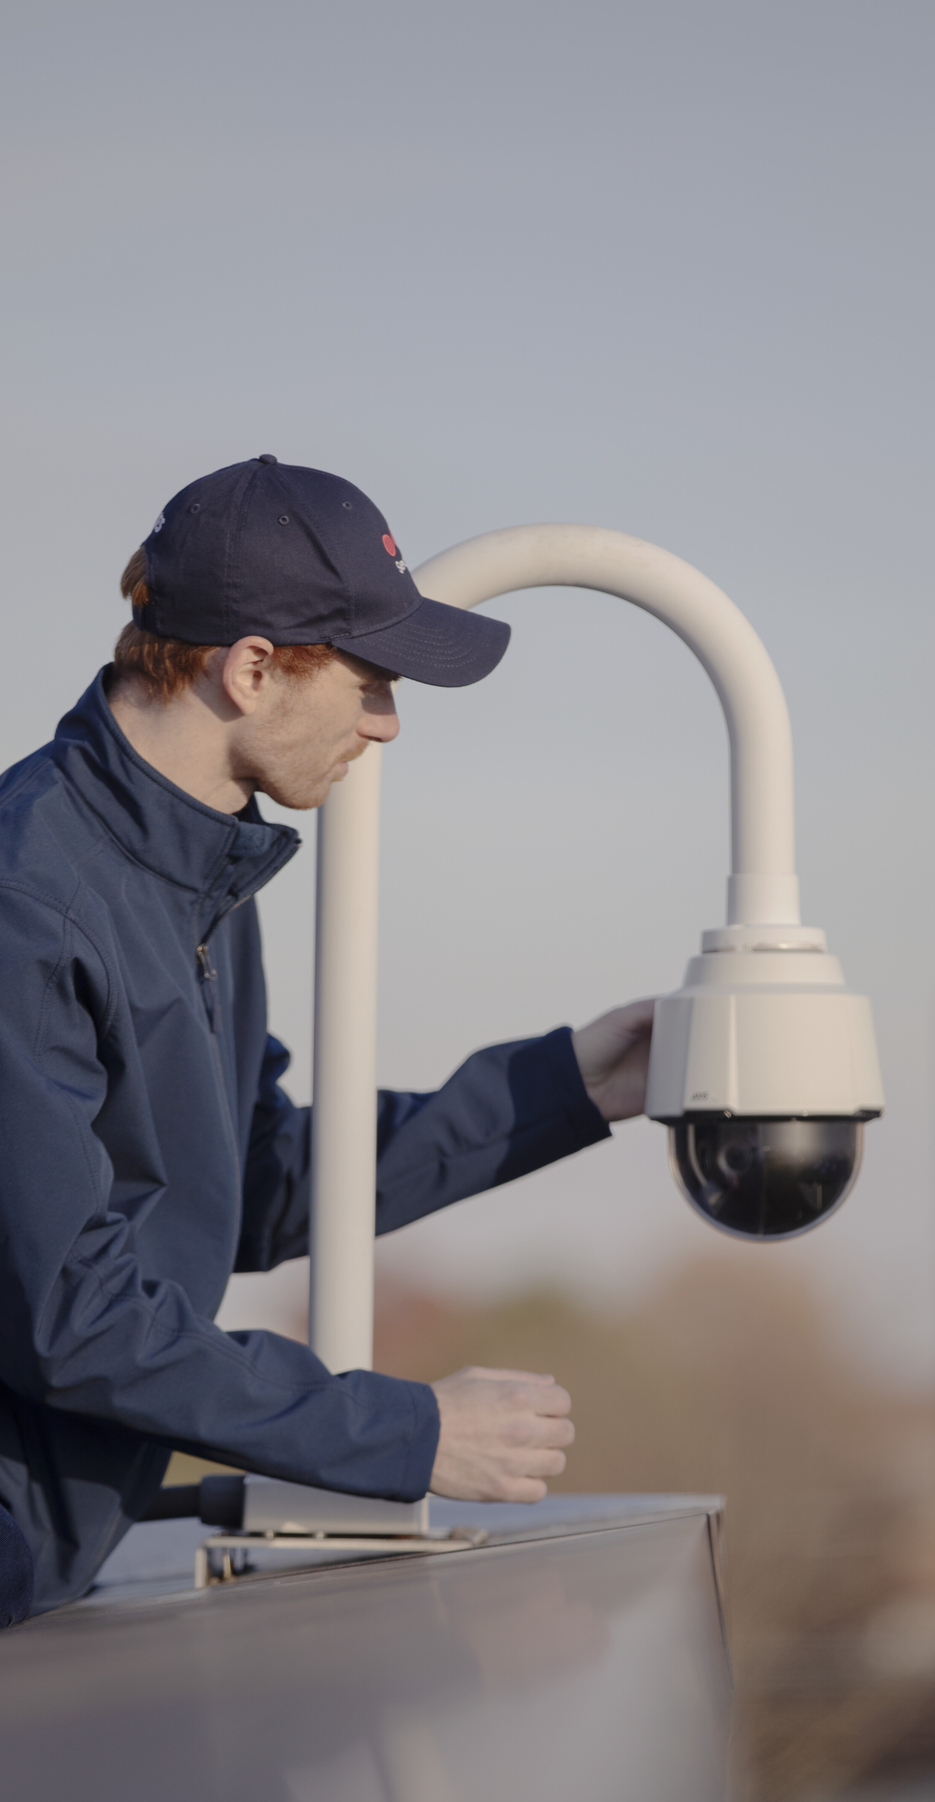
STANLEY Security overview
Geographic sales split (2021)
Active in technology services, focusing on installation, maintenance and monitoring
Primarily active in North America and Europe, with headquarters in Indianapolis
~7 800 highly skilled security professionals
Strong competitive position globally with more than 500 000 customers across millions of sites
Highly attractive RMR (Recurring Monthly Revenue) approx. 40% of sales
New innovative technology offerings in the health, safety and security space
MUSD
1 650
North America
Nordics
France
UK
Central EU
Sales type split (2021)
MUSD
1 650
RMR/T&M
Installation and products
Source: Rights Issue Prospectus Securitas AB (16 September 2022) (https://www.securitas.com/en/investors/rights-issue-2022/)

Slide 15
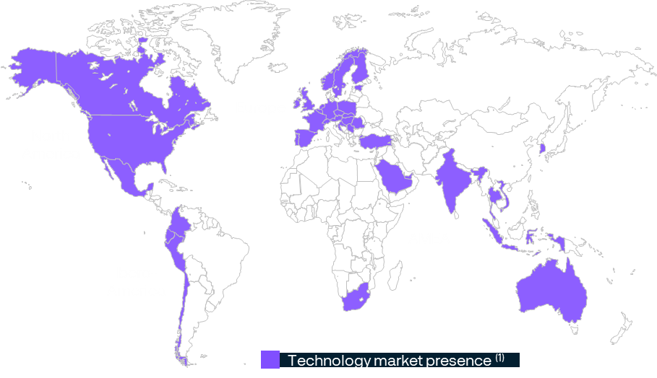
Securitas is now a global leader in technology
Strong market position
in strategic markets:
#2 globally
Including United States. Sweden, France, Spain, Norway, Finland, the Netherlands, the United Kingdom, Belgium, Canada, Denmark
Well diversified and positioned into the global commercial security technology market with strong position in key countries
Source: Management estimates (Securitas’ assessment based on Securitas’ sales of solutions and technology and STANLEY Security’s sales in 2021 in relation to competitors’ sales in 2021)
(1) Adjusted for Argentina divestment

Slide 16
Strong commercial and cost synergies with experienced integration team
Highly compelling and tangible cost synergies
Additional significant sustainable margin accretion potential
  Creating one common technology organization
  Strong commercial cross-selling and solutions synergies
+
  Consolidate back-office support
  Significant recurring revenue streams enhances revenue stability and profitability, through fixed cost absorption
  Overlap in support and operational facilities
  Innovative offering strengthens client value proposition with high-margin services
  Leveraging strengthened purchasing power
  STANLEY Products & STANLEY Healthcare offerings enhance portfolio and client share of wallet
MUSD 50
Cost synergies
(1)
Strong levers for continued margin expansion
(1) Source: Annual report 2021 (https://www.securitas.com/en/investors/financial-reports/annual-reports/)

Slide 17

Quality Security Services with global presence generating steady and strong cash flows
Leading global market position ⁽¹⁾
High-quality offering creating client value and retention
Successful price vs. wage management
Margin improvement focus
Global market position within Security Services:
#2
>150 000
clients with cross-selling and solutions opportunities
~90%
overall client retention
>95%
global client retention
Price/wage well managed from 2021 and 2022
Dynamic price management
Enabled by new digital platforms
Transformation programs
End-to-end digitalization transformation
Digitalized workforce management and client interaction
Increased operational and financial transparency
Active portfolio management
Profitability focus
Strong position in key markets globally
Leading mobile patrol and response network density
Security Services represented 66% of sales in H1 2023: focus on quality, productivity and profitability
(1) The Freedonia Group, Global Security Services, April 2022. Market position based on Securitas’ sales in 2021 in relation to its competitors’ sales in 2021

Slide 18
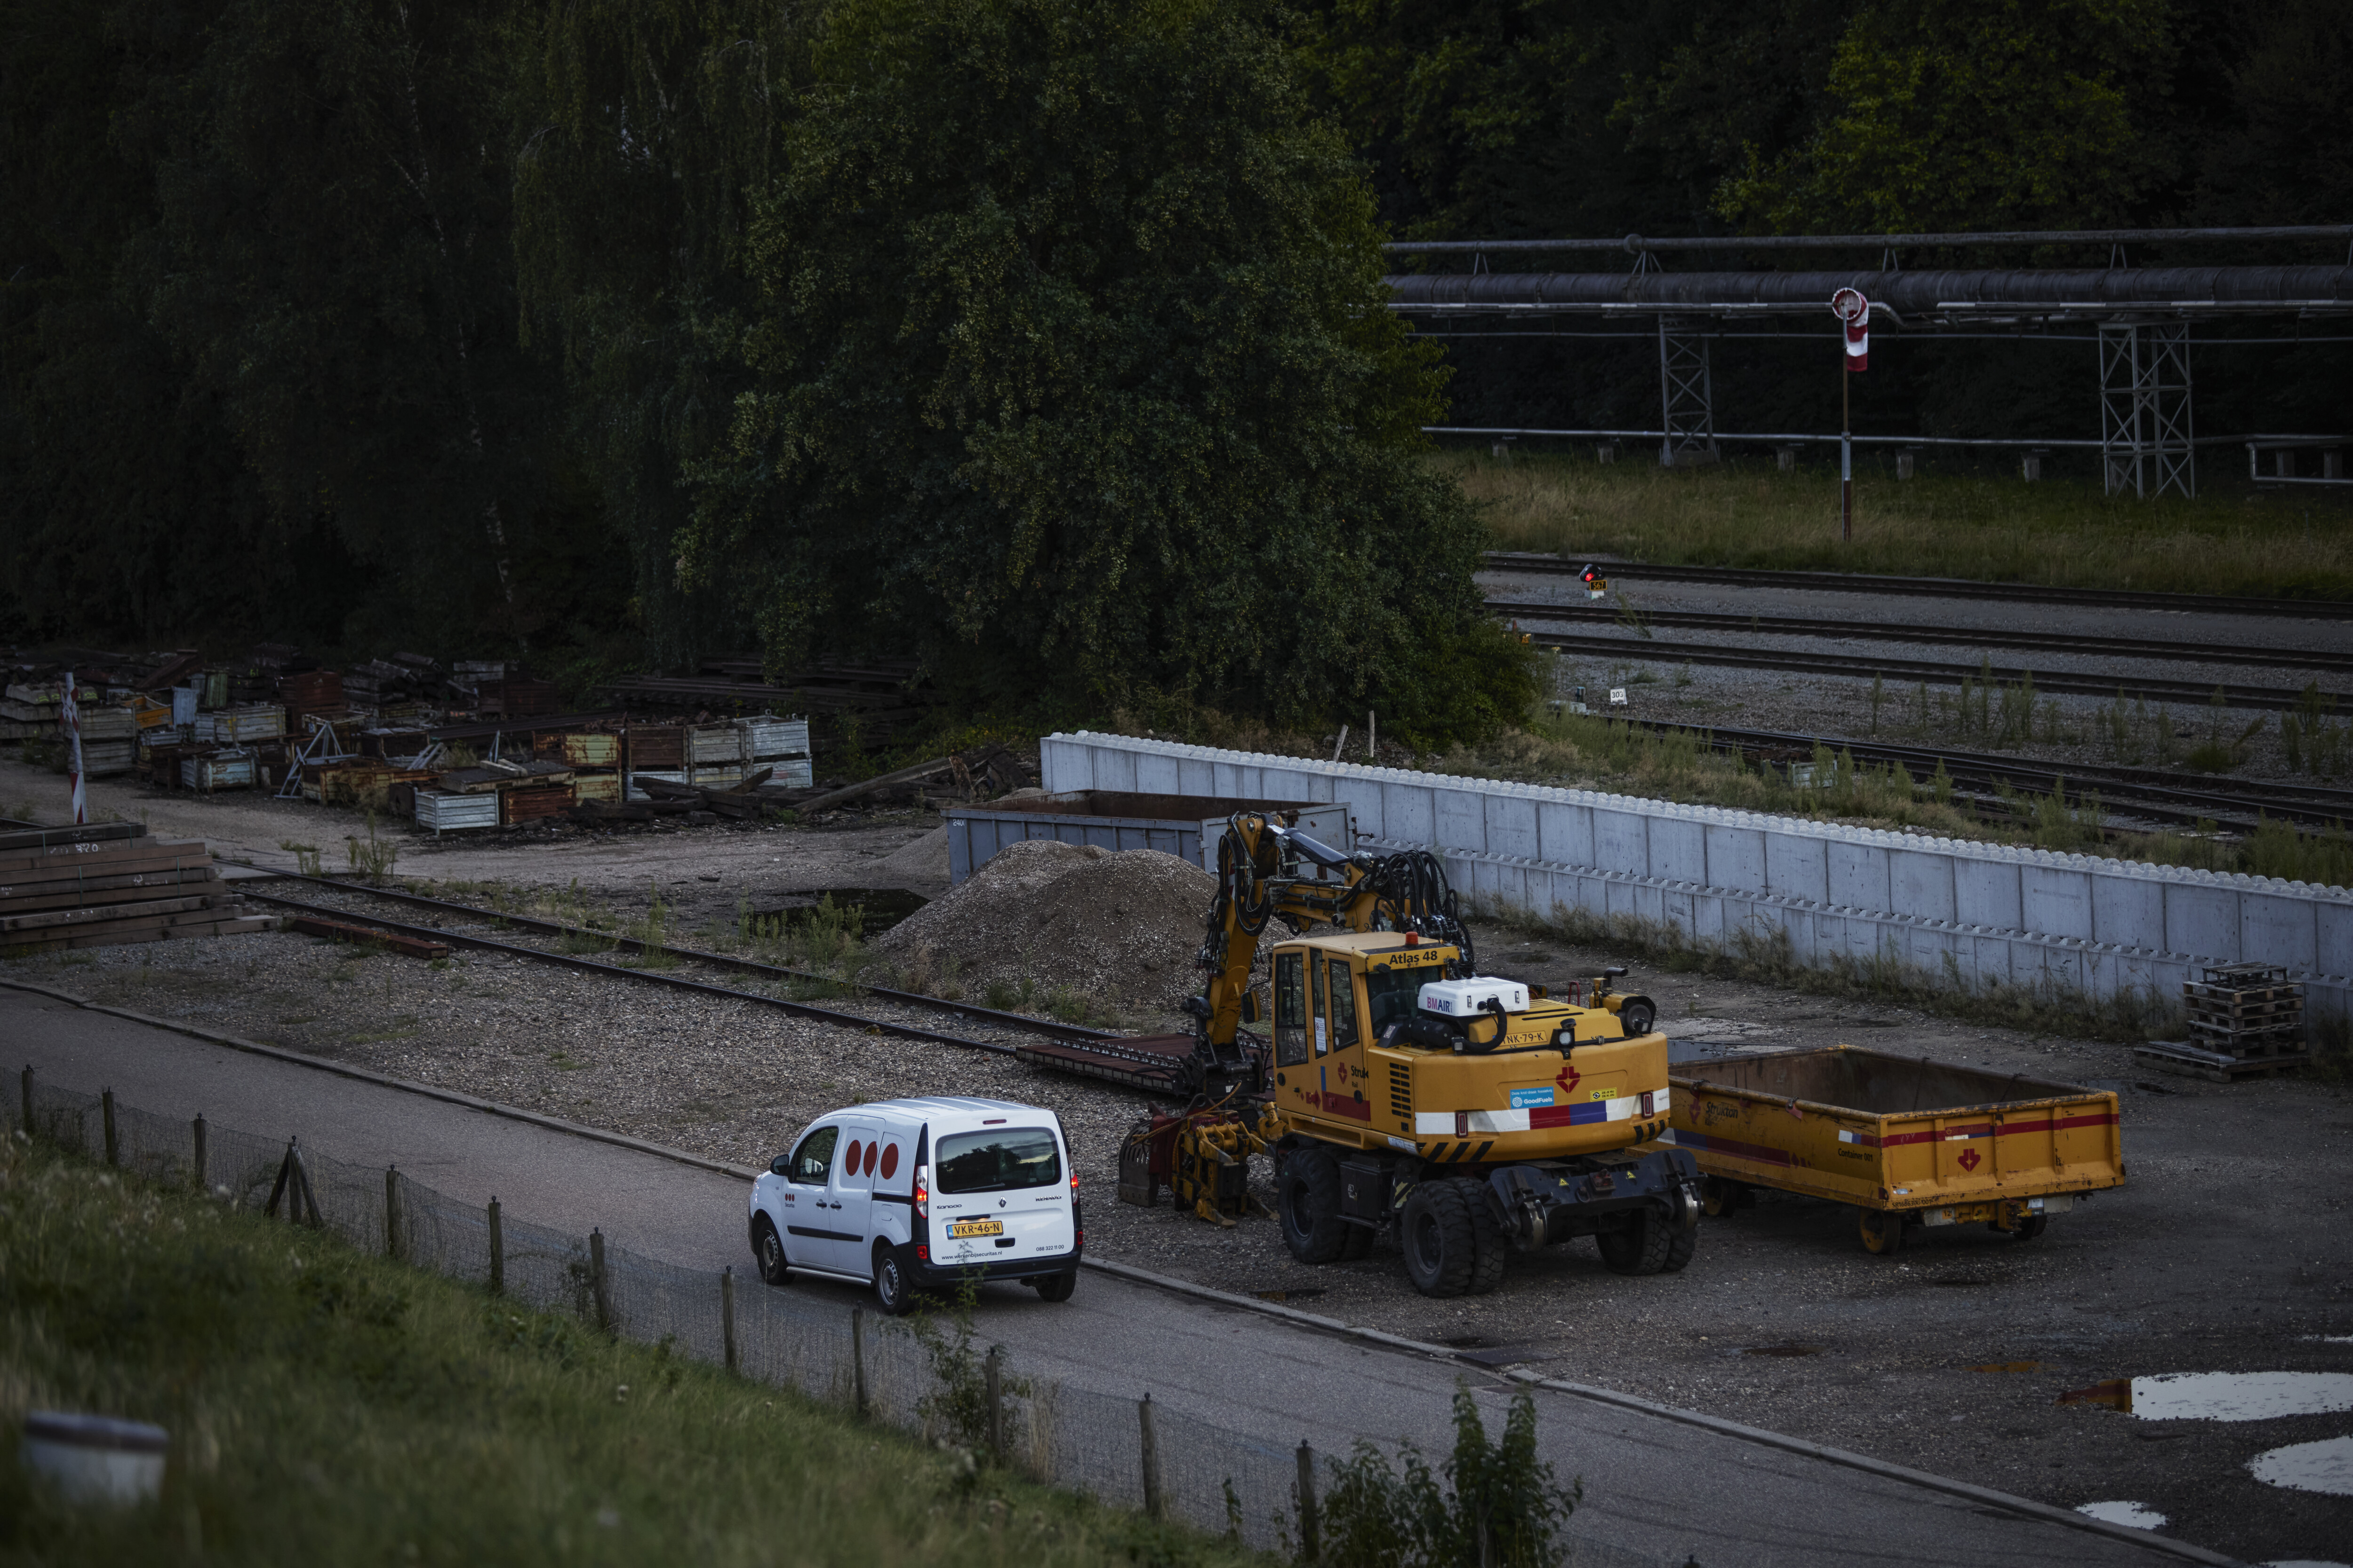
Financial overview

Slide 19

Securitas’ financial targets
Securitas
Superior growth
Higher margins
8-10%
Technology & Solutions annual average real sales growth ⁽¹⁾
8%
Group EBITA margin by year-end 2025
>10%
Long-term EBITA margin ambition
  A leading global Technology & Solutions provider with strong position in key geographical markets
  Compelling solutions and cross-selling opportunities
  Attractive M&A opportunities after deleveraging phase
  Increased exposure to high-margin Technology & Solutions market
  Strong cost synergies with STANLEY (MUSD 50)
  Margin enhancement through business transformation programs
  Active portfolio management and continuous review of non-performing contracts
Operating cash flow
70-80%
of operating income before amortization
Capital structure
<3x
Net debt to EBITDA-ratio
Dividend policy
50-60%
of annual net income over time
New additional disclosure from beginning of 2023:
Sales and operating income for security services, technology & solutions and risk management services and costs for Group functions
(1) Target for the 2022-26 period is sales growth adjusted for changes in exchange rates

Slide 20
Our strategy is delivering results
Group sales and EBITA margin development
Continuously higher operating margin compared to pre-pandemic years
Improved mix, higher T&S of total sales
Positive price/wage management throughout 2022 despite high inflationary environment
Transformation programs, first benefits realized
Cost efficiency throughout pandemic
Sharpened the business through exit program
Stanley acquisition and cost synergy contribution
2015
2016
2017
2018
2019
2020
2021
2022
H1
2022
Source: Securitas Annual reports 2015-2021 (https://www.securitas.com/en/investors/financial-reports/annual-reports/) and Securitas EMTN prospectus dated 15 November 2022, and as supplemented on 10 March, 23 May and 22 August 2023

Slide 21
Strong recurring cash flow generation supports our growth and investments
Operating cash flow (BSEK)
Free cash flow (BSEK)
Operating cash flow as % of EBITA
Free cash flow as % of adjusted income
Average operating cash flow of 86% since 2015
Portfolio business with steady, recurring cash flow profile over time
Low CAPEX need, less than 3% of sales including IFRS 16 historically, mainly solutions, IT and maintenance CAPEX
2022 cash flow burdened by non-recurring 700 MSEK C19 benefit repayment in the US. No further payments going forward
Solid foundation to deliver strong cash flows within our target range in coming years
2015-22 average: 86%
Target:
70-80%
2015
2016
2017
2018
2019
2020
2021
Source: Securitas Annual reports 2015-2021 (https://www.securitas.com/en/investors/financial-reports/annual-reports/), and EMTN prospectus dated 15 November 2022 and supplement dated 22 August 2023

Slide 22
Capital allocation focusing on deleveraging
Capital allocation 2014-2021
Coming ~12 to 24 months
Beyond
% of FCF
% of FCF – Illustrative only
% of FCF – Illustrative only
100%
100%
Other
Continued debt reduction or other capital allocations subject to leverage
113%
IAC already announced
Items affecting comparability (IAC)
Finalization of transformation programs in 2023
Majority of STANLEY Security transaction cost over 2022-23
M&A
M&A
Building our leading T&S position
Net debt reduction
Continued value accretive bolt-on M&A execution
Deleveraging post STANLEY transaction
Dividend
Dividend
Dividend
Dividend in the range of 50-60% of annual net income over time
Dividend in the range of 50-60% of annual net income over time
Dividend in the range of 50-60% of annual net income over time
Note: The capital allocation excludes lease liabilities, revaluation and translation
Source: ‘Presentation investor update 2022’ (https://www.securitas.com/en/investors/presentations/investor-days/)

Slide 23
Net debt to EBITDA target of <3x
Net debt development (BSEK) and leverage ratio
4.0x⁽¹⁾
3.7x⁽¹⁾
3.7x⁽²⁾
3.7x⁽²⁾
Adjusted Net debt / EBITDA 3.7x ⁽²⁾ in H1 2023
New financial target of net debt to EBITDA-ratio <3x, estimated to be reached in 2024⁽³⁾
1.9x
2.4x
2.0x
2.3x
2.2x
2.1x
1.9x
2015
2016
2017
2018
2019
2020
2021
2022
H1 2023
(1) As reported (2) Includes STANLEY Security’s 12 months adjusted estimated EBITDA (3) Source: Rights Issue Prospectus Securitas AB (16 September 2022) (https://www.securitas.com/en/investors/rights-issue-2022/)

Slide 24
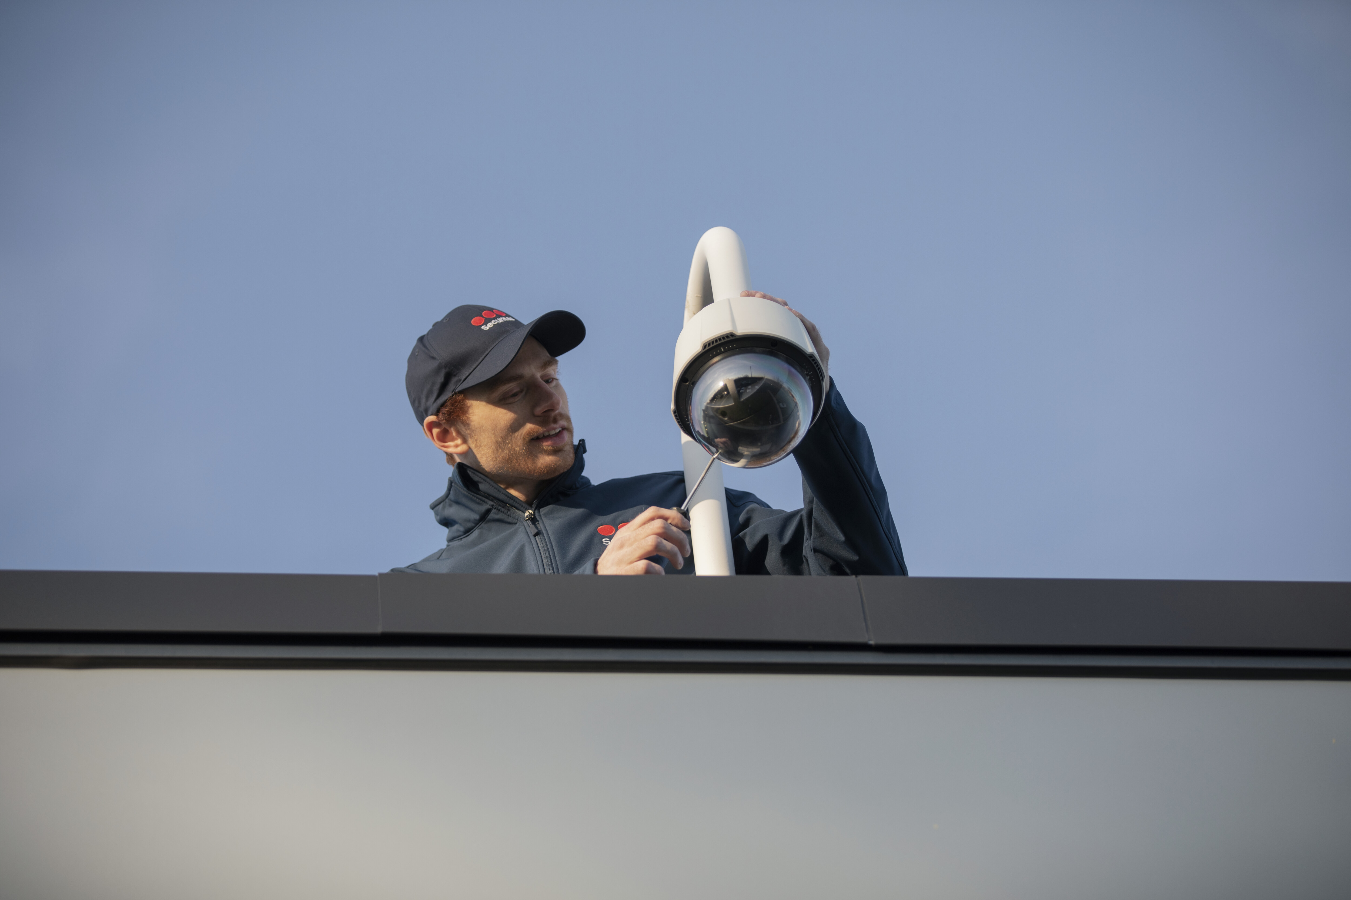
Financing update

Slide 25
Financing overview – Committed to investment grade rating
No financial covenants
Strong liquidity at end of Q2 2023: BSEK 5.5
MEUR 1 029 RCF matures in 2027 and fully undrawn end Q2 2023
Bridge facilities related to BUSD 3.3 STANLEY Security acquisition
  MUSD 915 bridge to equity facility fully repaid after successful completion of BSEK 9.6 rights issue in October 2022
  Bridge to debt facility with maturity in July 2024. Initial amount MUSD 2 385
  MUSD 75, 6-year Private Placement with SEK drawn on January 10, 2023
  4+1 years term loan of MEUR 1 100 completed on January 18, 2023, with 9 relationship banks
  MEUR 300 Schuldschein issuance completed on February 24th, 2023
  MEUR 600 Eurobond executed on Mar 30th 2023, closed Apr 4th 2023
  Bridge facility remaining as per June 30, 2023: MUSD 159, fully repaid in July 2023
Committed Funding Maturity Profile as at June 30th
MSEK
Strong Group of Core Banks:
Bank of America | BBVA | CIC
Citibank | Commerzbank | Danske Bank
DnB | ING | KBC
SEB | Unicredit
Securitas is committed to Investment Grade rating
Source: Company

Slide 26
S&P Rating - Credit strengths and risks
Agency | S&P
Long-Term | BBB-
Short-Term | A-3
Swedish Short-Term | K-3
Outlook | Positive
Key Strengths
Largest security provider, wide geographical presence, well diversified customer base across vertical markets
Successful track record of integrating acquisitions
Operates a strong liquidity position
Key Risks
Competitive and fragmented industry with low entry barriers especially in manned guarding leading to modest EBITDA margins
Company has operations in high-risk countries, such as Argentina where economic conditions remain challenging (Note, Argentina divested July 2023)
Competitive market environment given consolidating industry and potential pressure on wage price
On 11 August 2023, S&P published a positive outlook for the BBB- long-term credit rating
“Securitas is on track to post strong 2023 results, with double digit revenue growth and solid margin expansion.“
“We forecast (this) growth will drive lower adjusted leverage of about 3.1x by year-end 2023 and 2.6x by year-end 2024.”
“The positive outlook reflects the forecast improvement in credit ratios and supportive financial policy.”
Source: S&P Global Ratings Full analysis dated 3 June 2022 and S&P Global Ratings Research update dated 11 August 2023.

Slide 27

Investment
Highlights

Slide 28
Investment highlights
Securitas is a resilient business with strong growth and margin prospects
#2 global market positioning in both security services and technology after acquisition of Stanley
Leading client offering with 90% retention rate, strong recurring revenue and portfolio of essential services revenue
Diverse customer base across 650k+ clients ⁽²⁾ in 44 markets ⁽¹⁾
Consistent, long-term strategy with improved margins and strong price / wage management
Proven track record of stability and resilience throughout economic downturn and crises
Low working capital and capex needs generating solid cash flows throughout the cycle
Well managed debt and funding, supported by strong group of relationship banks
Committed to investment grade rating
No operations in Ukraine/Russia
(1) Adjusted for Argentina divestment (2) Not adjusted for Argentina divestment

